Slide 1
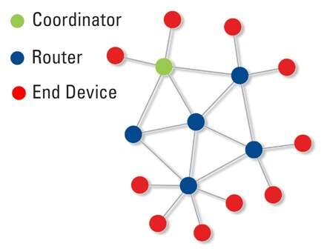
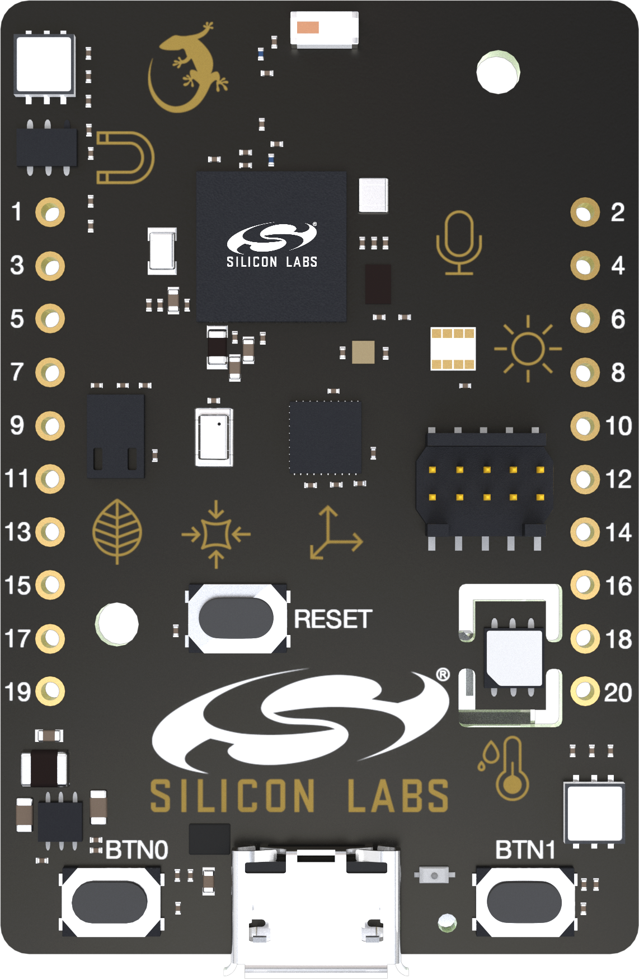


Zigbee network
Light sensor node
Si1133
UV and Ambient light sensor
Thunderboard Sense 2
BRD4166A
SINK ← PROXY ← SOURCE
Z3 frame
To GP cluster
GP frame
(GP cluster to HA data translator
GP commissioner and GP data user)
(relay to GP cluster server)
(data provider)
Any Zigbee 3.0 node with:
Endpoint 242 + Cluster 0x0021 GP server
Cluster 0x0400 Illuminance measurement
Any Zigbee 3.0 certified router node using its:
Endpoint 242 + Cluster 0x0021 GP client
Only pure Green Power node
Connected to Zigbee 3.0 Cluster 0x0400
Can be the integrated in the same node

